Slide 1
MySQL Installation and JDBC Connectivity
Unit V
What is MySQL
Installation and Working
Java Connectivity with MySQL

Slide 2
What is MySQL?
MySQL is a very popular, open source database.
Handles very large databases; very fast performance.
Why are we using MySQL?
Free (much cheaper than Oracle!)
Open source
Easy to use Shell for creating tables, querying tables, etc.
Easy to use with Java JDBC

Slide 3
Where can I get MySQL ?
http://www.mysql.com/downloads/
Make sure you pick the correct version for your OS
Download MySQL 5.0 Community Server GA

Slide 4
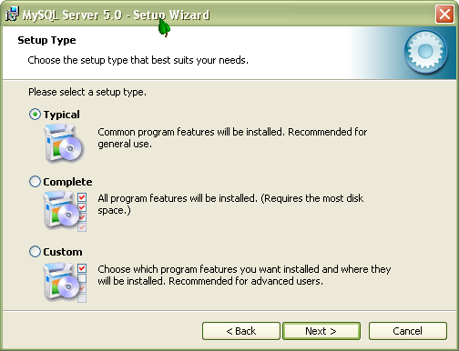
Installing the server
Follow the screenshots

Slide 5
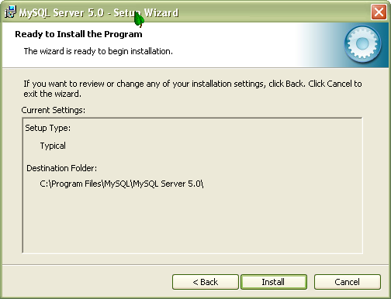
Installing the server

Slide 6
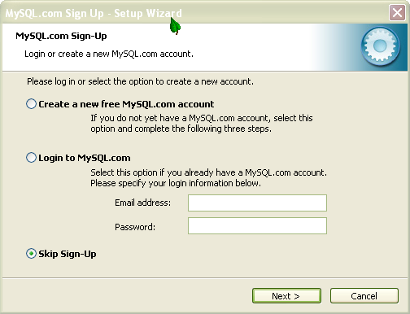
Installing the server

Slide 7
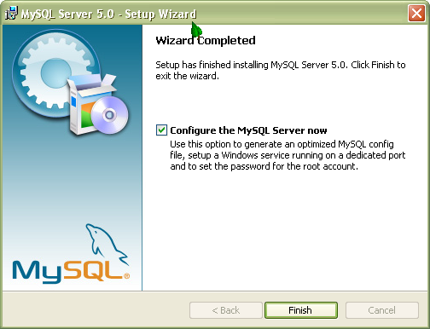
Installing the server

Slide 8
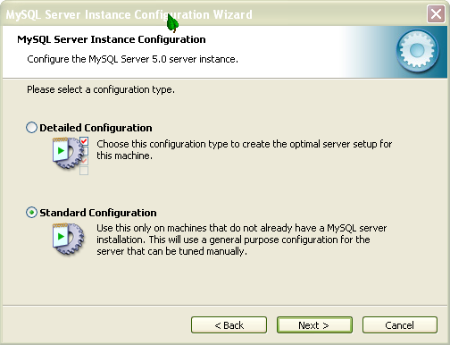
Installing the server

Slide 9
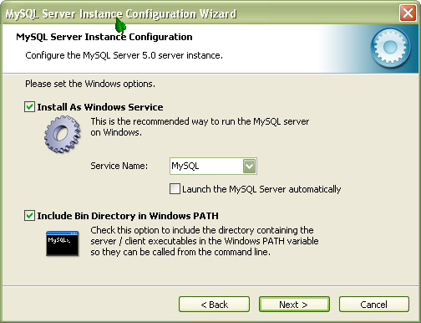
Installing the server

Slide 10
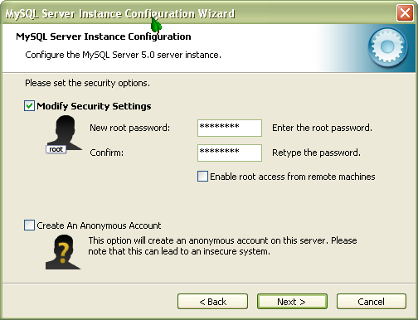
Installing the server

Slide 11
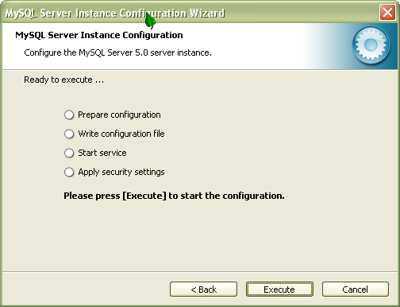
Installing the server

Slide 12
Working with MySQL Database

Slide 13
Creating Database Using MySQL
To Create a database
mysql> CREATE DATABASE <db_name>;
To make this as a current database
mysql> USE <db_name>;
To view the current database selected
mysql> SELECT DATABASE();

Slide 14
Creating Database Using MySQL
mysql> create database db1;
mysql> use db1;
mysql> select database();

Slide 15
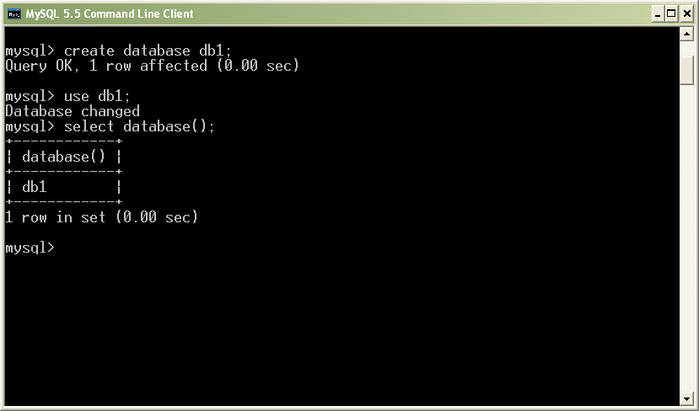
Creating Database Using MySQL

Slide 16
Create a Table
The command that is used to create a table in SQL
mysql> CREATE TABLE <table_name> (attribute 1 datatype1, attribute 2 datatype2,…)
To know the list of tables in the current database
mysql> SHOW TABLES
To view the table
mysql> DESCRIBE <table_name>

Slide 17
Data Types
Data type | Description
INT | normal-sized integer, You can specify a width of up to 11 digits.
BIGINT | A large integer that can be signed or unsigned
FLOAT(M,D) | define the display length (M) and the number of decimals (D)
DOUBLE(M,D) | A double precision floating-point number that cannot be unsigned
DATE | A date in YYYY-MM-DD format
DATETIME | A date and time combination in YYYY-MM-DD HH:MM:SS format
TIME | HH:MM:SS format.
CHAR(M) | A fixed-length string between 1 and 255 characters in length
VARCHAR(M) | A variable-length string between 1 and 255 characters in length

Slide 18
Create a Table
mysql> create table student (roll int, name varchar(15), dept varchar(10) );
Table Name: student
roll | name | dept

Slide 19
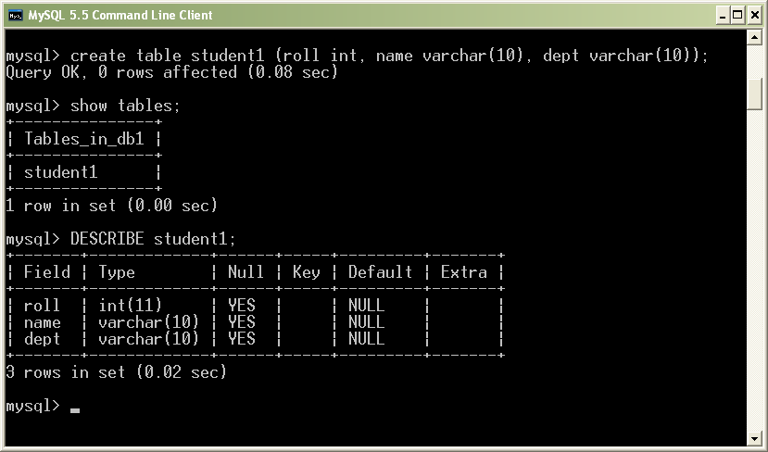
Create a Table

Slide 20
Inserting Values
mysql> insert into student values (1, ‘Arun’, ‘cse’);
Table Name: student
roll | name | dept
1 | Arun | cse

Slide 21
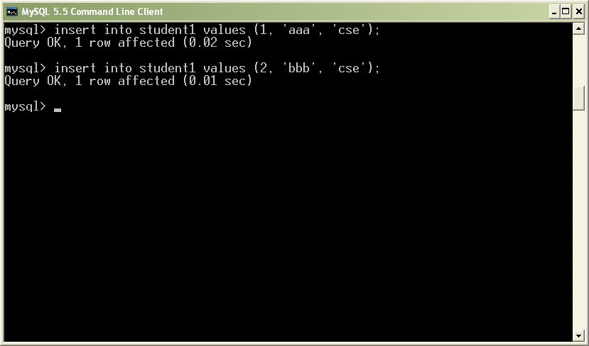
Insert Values

Slide 22
Select Command
sql> select * from student;
roll | name | dept
1 | Arun | cse
2 | Babu | cse
3 | Chitra | IT

Slide 23
Select Command
sql> select * from student where roll=1;
roll | name | dept
1 | Arun | cse

Slide 24
Select Command
sql> select * from student where dept=‘cse’;
roll | name | dept
1 | Arun | cse
2 | Babu | cse

Slide 25
Modify a Table
Syntax:
UPDATE table_name SET column1 = value1, column2 = value2, ... WHERE condition;
Example:
update student set name=‘akhil’, dept=‘IT’ where roll=2;

Slide 26
Modify a Table
Syntax:
DELETE FROM table_name WHERE condition;
Example:
delete from student where roll=2;
Or
delete from student where dept=‘cse’;

Slide 27
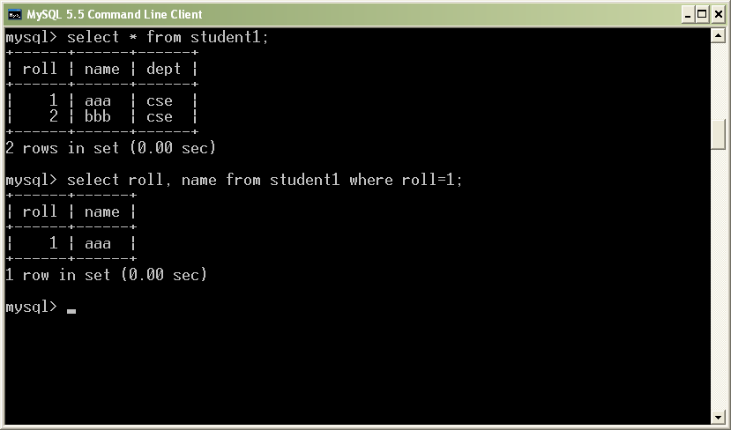
Select command

Slide 28
MySQL with Java Connectivity

Slide 29
Procedure
Start a new project in Netbeans
Open “services” tab
Right Click “Databases” → New Connection

Slide 30
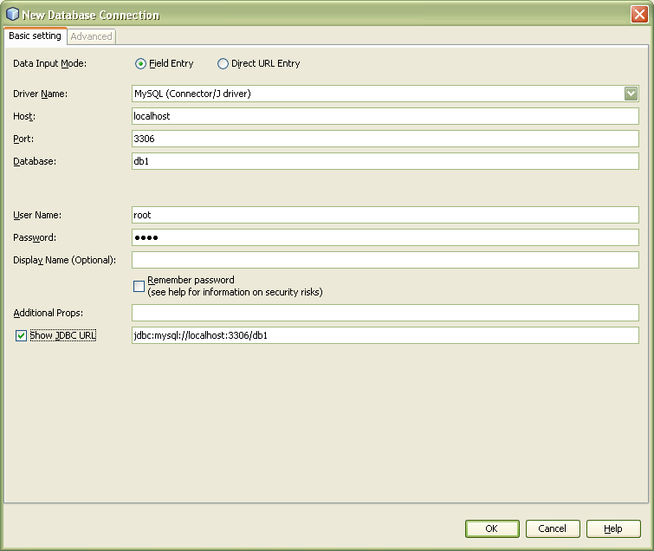

Slide 31
The Connectivity Code
Class.forName("com.mysql.jdbc.Driver");
String connectionurl = "jdbc:mysql://localhost:3306/db1?";
Connection con= (Connection) DriverManager.getConnection(connectionurl, "root", "root");
Statement st = con.createStatement();

Slide 32
public class Main {
public static void main(String[] args) throws Exception {
Class.forName("com.mysql.jdbc.Driver");
String connectionurl = "jdbc:mysql://localhost:3306/db1?";
Connection con= (Connection) DriverManager.getConnection(connectionurl, "root", "root");
Statement st = con.createStatement();
int rows=0;
rows = st.executeUpdate("insert into student values(3,'ccc','it')");
if(rows==0)
{
System.out.println("Not Updated");
}
else
System.out.println("Updated");
} st.close(); con.close(); }

Slide 33
Inserting using Variables
int roll=3;
String name=“Chitra”;
String dept =“IT”;
rows = st.executeUpdate ("insert into student values("+roll+",'"+name+" ', '" +dept+"')");

Slide 34
void display(JTable jTable1) throws Exception
{
int roll;
String name;
String dept;
Class.forName("com.mysql.jdbc.Driver");
String connectionurl = "jdbc:mysql://localhost:3306/db1?";
Connection con= (Connection) DriverManager.getConnection(connectionurl, "root", "root");
Statement st = con.createStatement();
ResultSet s;
s = st.executeQuery("select * from student");

Slide 35
int row=0;
int col=0;
while(s.next())
{
col=0;
roll=s.getInt(1);
name=s.getString(2);
dept=s.getString(3);
jTable1.setValueAt(roll, row, col);
col++;
jTable1.setValueAt(name, row, col);
col++;
jTable1.setValueAt(dept, row, col);
row++;
}
s.close(); st.close(); con.close();
}
}
 | Col=0 | Col=1 | Col=2
Row=0 | 1 | arun | cse
Row=1 | 2 | Babu | cse
Row=2 | 3 | Chitra | IT

Slide 36
package my.JavaApplication12;
import java.sql.*;
import javax.swing.JTable;
/**
*
* @author Admin
*/
public class database {
void insert(int id, String name) throws Exception
{
Class.forName("com.mysql.jdbc.Driver");
String connectionurl = "jdbc:mysql://localhost:3306/db1?";
Connection con= (Connection) DriverManager.getConnection(connectionurl, "root", "root");
Statement st = con.createStatement();
int rows;
rows = st.executeUpdate("insert into emp values ("+id+",'"+name+"')");
if (rows>0)
System.out.println("Updated");
else
System.out.println("Not Updated");
st.close();
con.close();
}
void display(JTable jTable1) throws Exception
{
int id;
String name;
Class.forName("com.mysql.jdbc.Driver");
String connectionurl = "jdbc:mysql://localhost:3306/db1?";
Connection con= (Connection) DriverManager.getConnection(connectionurl, "root", "root");
Statement st = con.createStatement();
System.out.println("hello");
ResultSet s;
s=st.executeQuery("select * from emp");
int row=0;
int col=0;
while(s.next())
{
col=0;
id=s.getInt(1);
name=s.getString(2);
jTable1.setValueAt(id, row, col);
col++;
jTable1.setValueAt(name, row, col);
row++;
System.out.println(id+" "+name);
}
s.close();
st.close();
con.close();
}
}

